Slide 1
CS2040S Tutorial 6
Done by Xiao Yan

Slide 2
Q1 Priority Queue
Given n unique elements, find the top k highest value element
Find a method that is better than sorting and output k largest element

Slide 3
Q1 a) Solution
Given n unique elements, find the top k highest value element
Find a method that is better than sorting and output k largest element
Quick Select on Kth element! And you already found all elements, is it?

Slide 4
Q1 b)
Given a stream of n unique elements, propose a data structure that maintains the top k highest value element
insertNext(x): adds a new item x into the data set
getKLargest(): returns the current top k highest value elements in the data set

Slide 5
Q1 b) Solution
Maintain a min priority queue of no more than k elements:
insertNext(x): adds a new item x into the data set
Add the new element x into the PQ;
If the PQ contains more than k elements, keep removing the smallest element until priority queue size is k
getKLargest(): we can simply return all the elements in the PQ

Slide 6
Q1 b) Solution Time Complexity
N calls of insertNext is O(N log k)
hidden removeMin() in PQ during insertNext() also O(log k)

Slide 7
Q2 Union Find (a)
What is the worst-case running time of the find operation in Union-Find with path compression (but no weighted union i.e Quick-Union with past compression)?

Slide 8
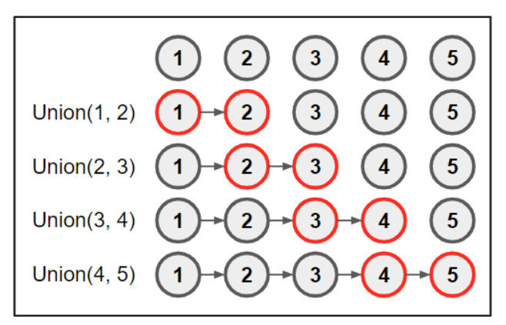
Q2 Union Find (a)
What is the worst-case running time of the find operation in Union-Find with path compression (but no weighted union i.e Quick-Union with past compression)?
Θ(n)

Slide 9
Q2(b)
Here’s another algorithm for Union-Find based on a linked list. Each set is represented by a linked list of objects, and each object is labelled (e.g., in a hash table) with a set identifier that identifies which set it is in. Also, keep track of the size of each set (e.g., using a hash table). Whenever two sets are merged, relabel the objects in the smaller set and merge the linked lists. What is the running time for performing m Union and Find operations, if there are initially n objects each in their own set?
More precisely, there is: (i) an array id where id[j] is the set identifier for object j; (ii) an array size where size[k] is the size of the set with identifier k; (iii) an array list where list[k] is a linked list containing all the objects in set k.

Slide 10
Q2(b)
Find is obviously O(1)

Slide 11
Q2(b)
m Union: O(mlogm)
Only relabelling list[k2] is expensive
Biggest set is of size O(m) as m Union
Size of smaller set at least doubles when union → Each object only relabelled logm times
Note: This is the total cost. Some Union are expensive and some are cheap

Slide 12
Q2 (c)
Design a data structure that supports three operations:
getNextTask(name) that returns the next task for the corporation with the specified name.
executeNextTask(name) that returns the next task for the corporation with the specified name and removes it from the set of tasks that corporation does.
merge(name1, name2, name3) that merges corporation with names name1 and name2 into a new corporation with name3.
Give an efficient algorithm for solving this problem.

Slide 13
Q2(c) Solution
Similar to previous one, replace list with Priority Queue(Heap)
Merge: insert tasks from smaller heap to larger heap – O(log(mn))
At most mn task in total
Each item copied (inserted) at most logn times
Total cost: O(nm(logn)(logmn))

Slide 14
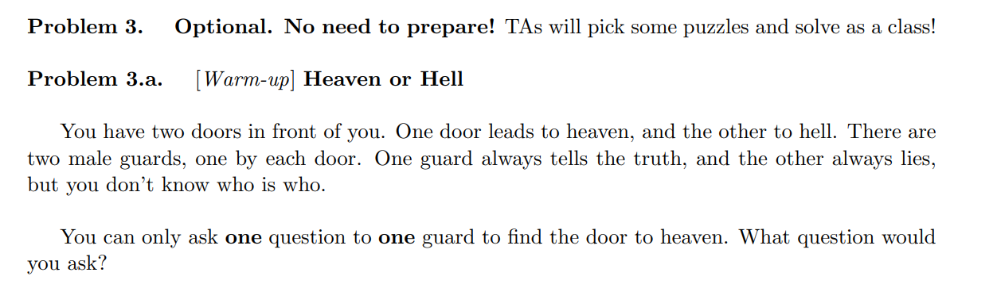
Q3(a)

Slide 15
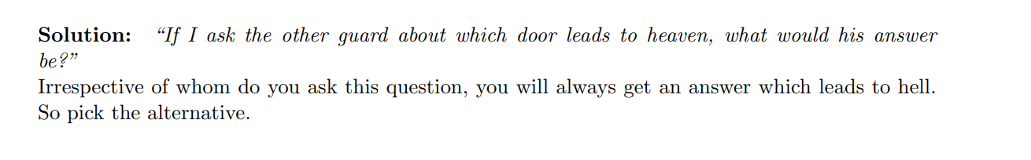

Slide 16
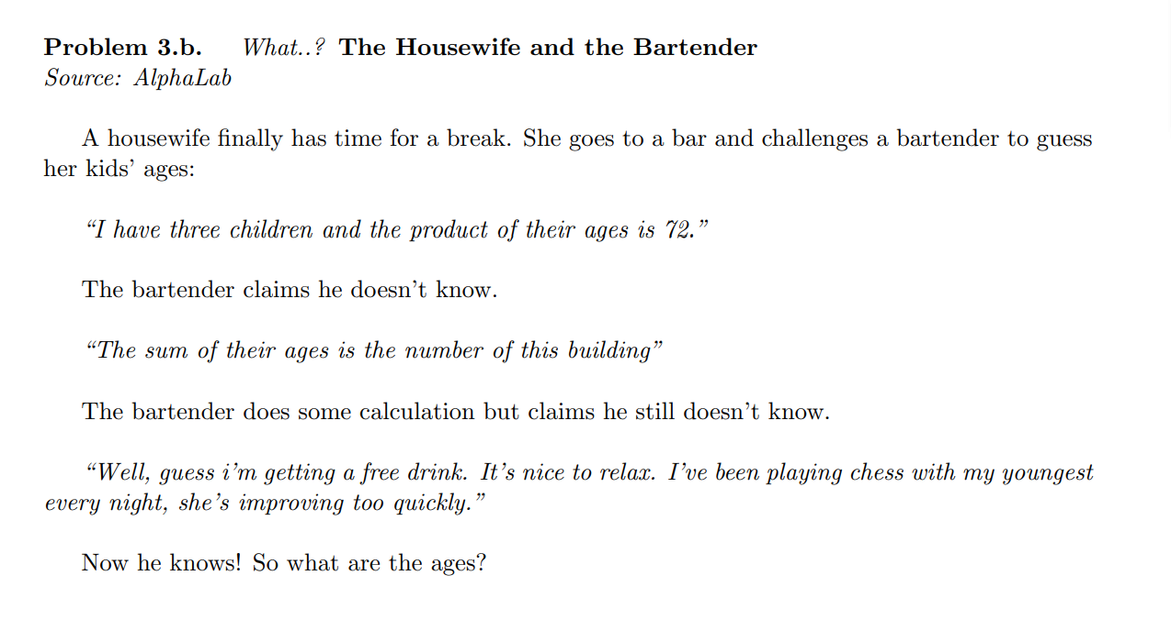
Q3(b)

Slide 17
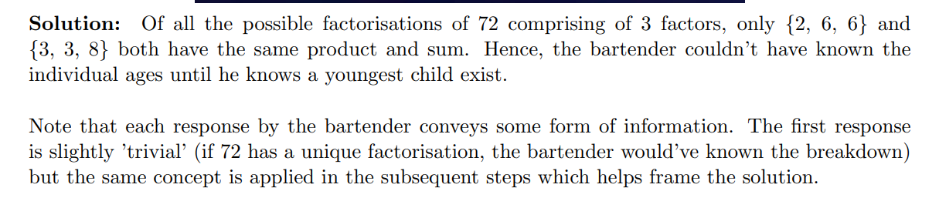

Slide 18
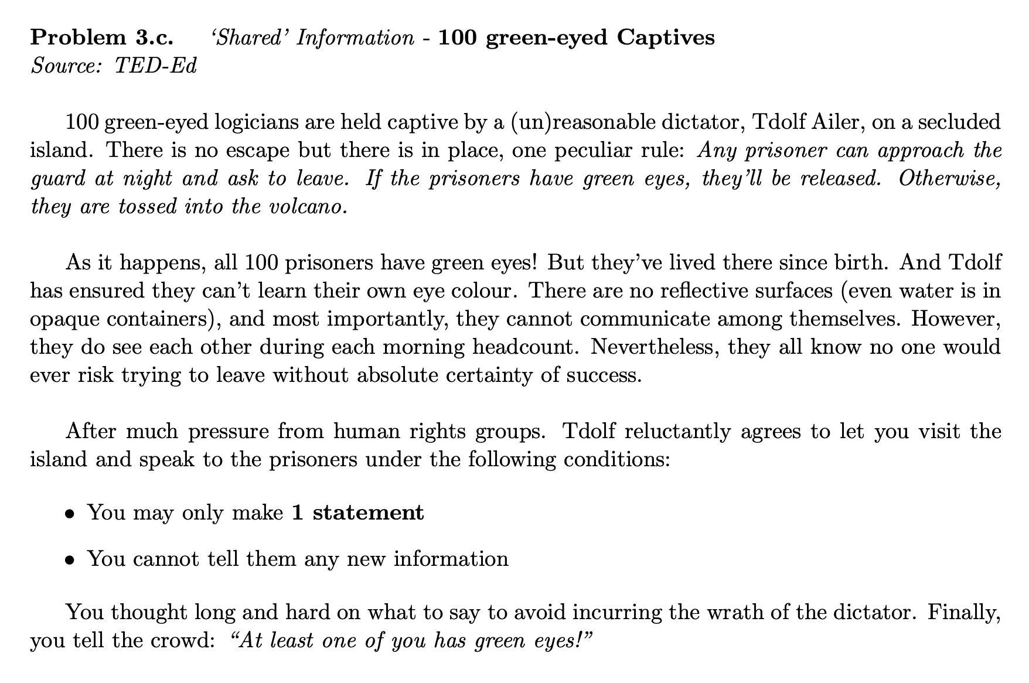
Q3 (c)

Slide 19
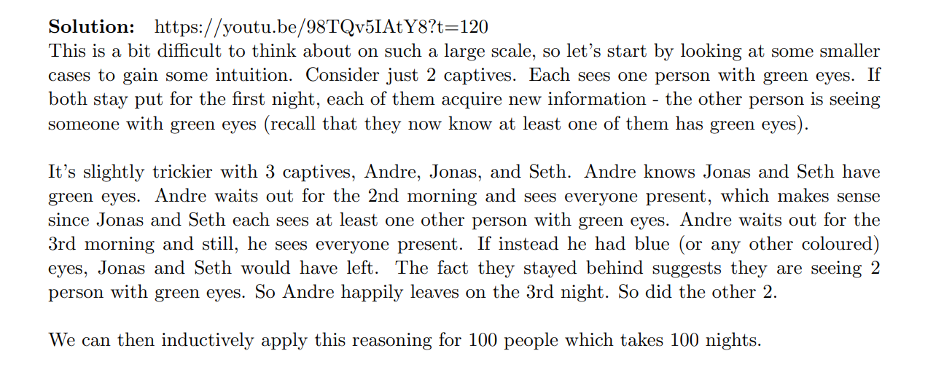
Q3(c)

Slide 20
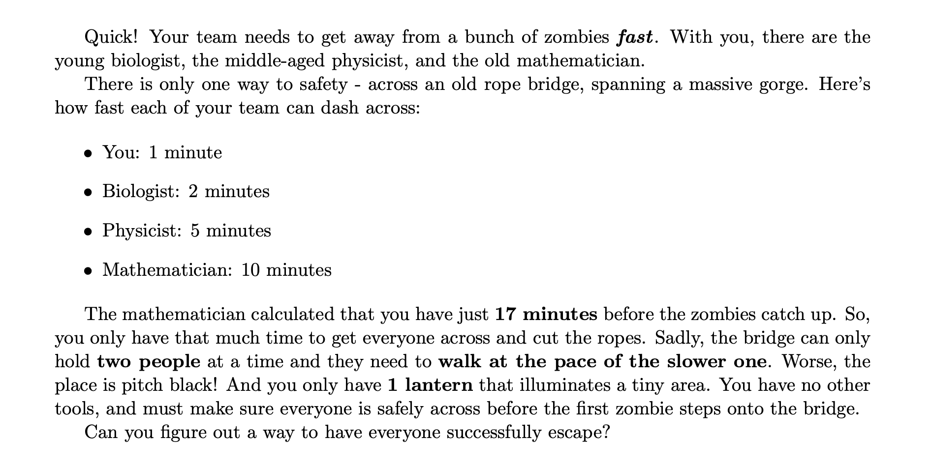
Q3 (d)

Slide 21
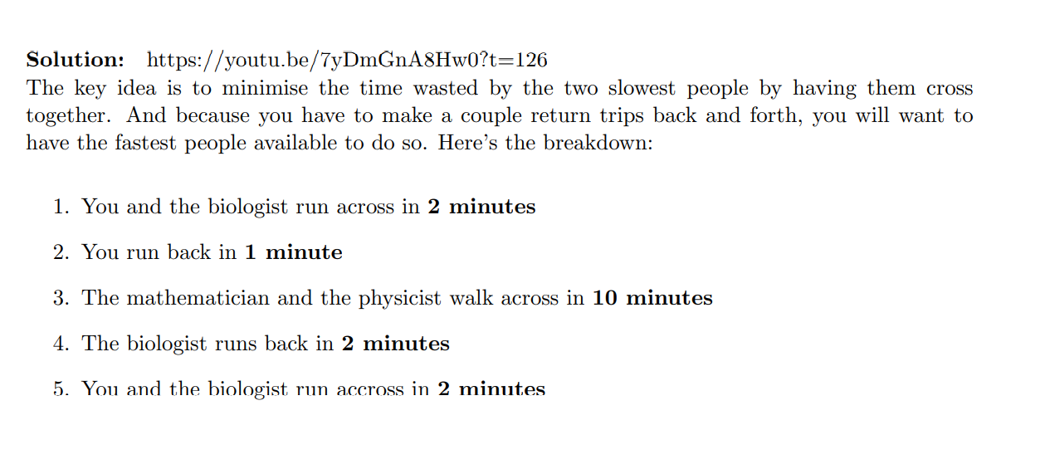
Q3(d)

